Slide 1
Hyperlinks, Images and Tables
Part 1

Slide 2
Overview…
We will look at…
What is Hypertext.
How hyperlinks are used to navigate to World Wide Web
Creating hyperlinks
Types of Hyperlinks
Hyperlink Styling

Slide 3
Hyperlinks, Images and Tables
The, that are connected via Uniform Resource Locators (URL) via hyper test links.
World Wide Web is an collection of information of documents and other resources that are identified by Uniform Resource Locators (URLs).
Interlinked via hypertext and accessed via internet.
So how do we display these resources?
Hyperlinks
Images
Tables

Slide 4
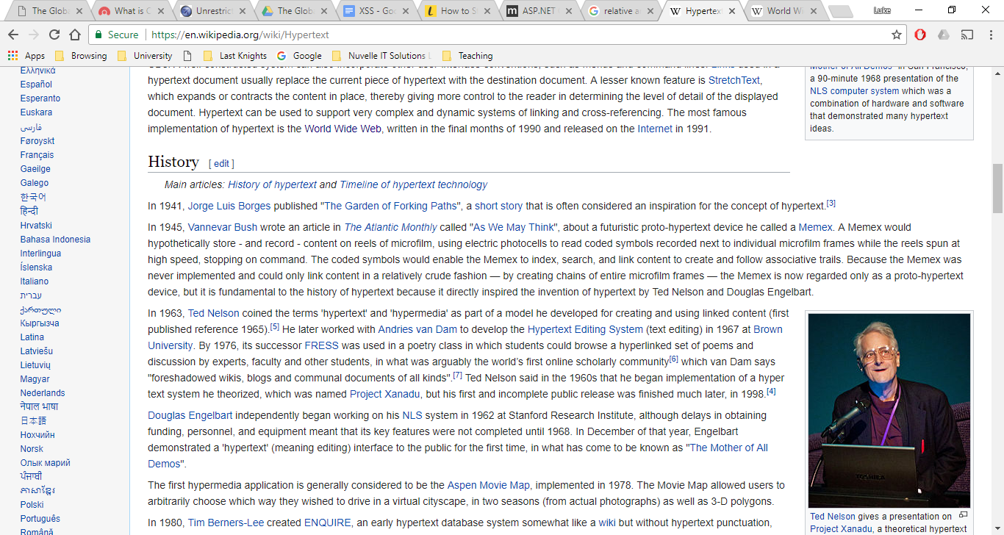
Hypertext and Hyperlinks
Hypertext was originally created around 40 years before the world wide web.
(https://en.wikipedia.org/wiki/Hypertext)
What if you wanted to know more about “The Garden of Forking Paths”?

Slide 5
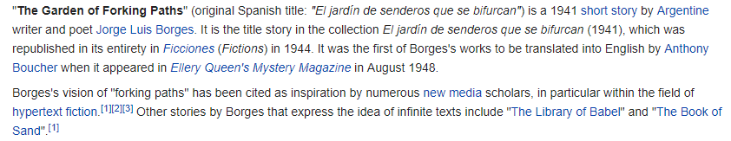
Hypertext and Hyperlinks
Link:
When clicked, were transports us to the topic selected by the user.
In this case:
(https://en.wikipedia.org/wiki/The_Garden_of_Forking_Paths)

Slide 6
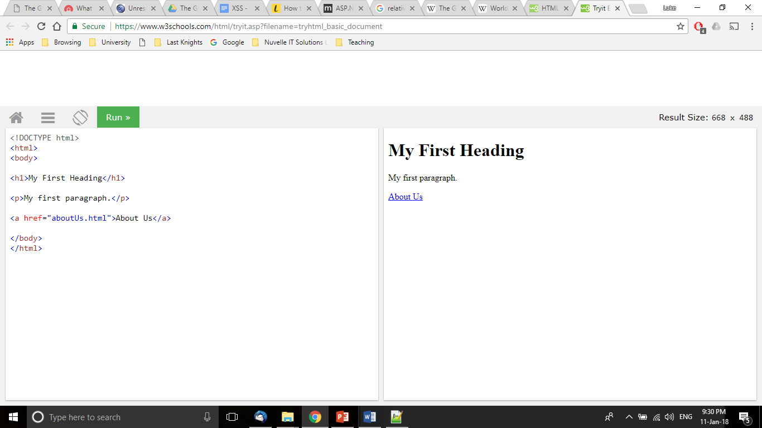
Creating the Link
The page is written with Hyper Text Mark-up Language.
Links are created through the use of <a></a> tags.
Links are broken into two sections.
Link address
Text shown to users
By using this link we will be redirected to “aboutUs.html”

Slide 7
Absolute and Relative Hyperlinks
There are a range of different hyperlinks that can be used.
Each of the links are broken down into two types of hyperlinks.
Absolute Hyperlinks
<a href=“www.google.com”>Google</a>
Relative Hyperlinks
<a href=“../aboutUs.html”>About Us</a>

Slide 8
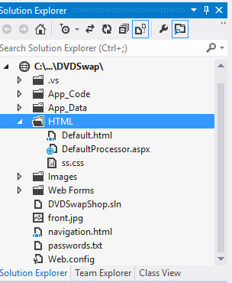
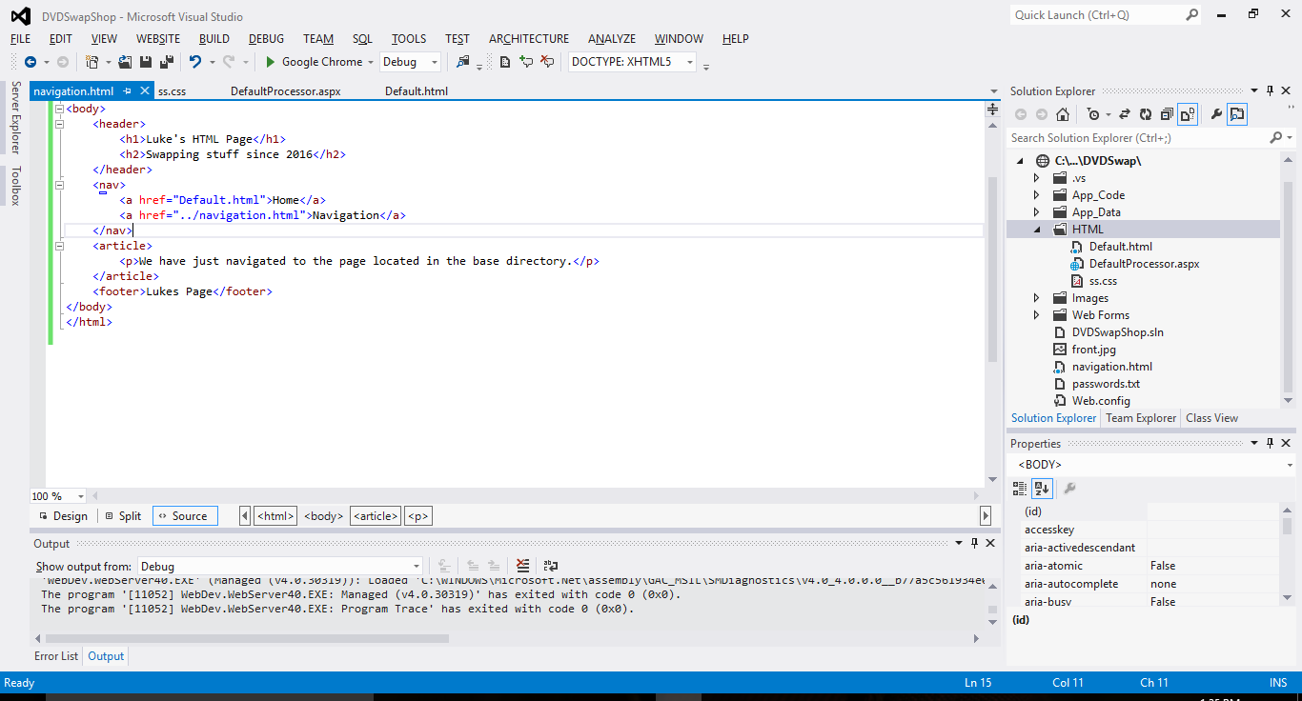
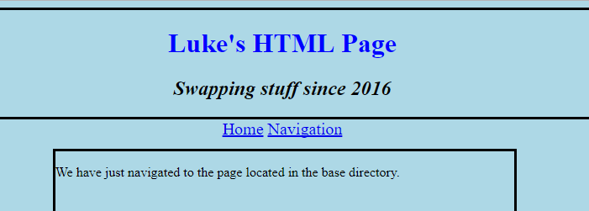
Directory Navigation
With the use of links we can also navigate through directories within the file structure.
What if we wanted to navigate to a new section of the website?
Lets try and access the navigation.html from default.html….
By making use of the “../” within the hyperlink. We can go up one level of the file structure.
D

Slide 9
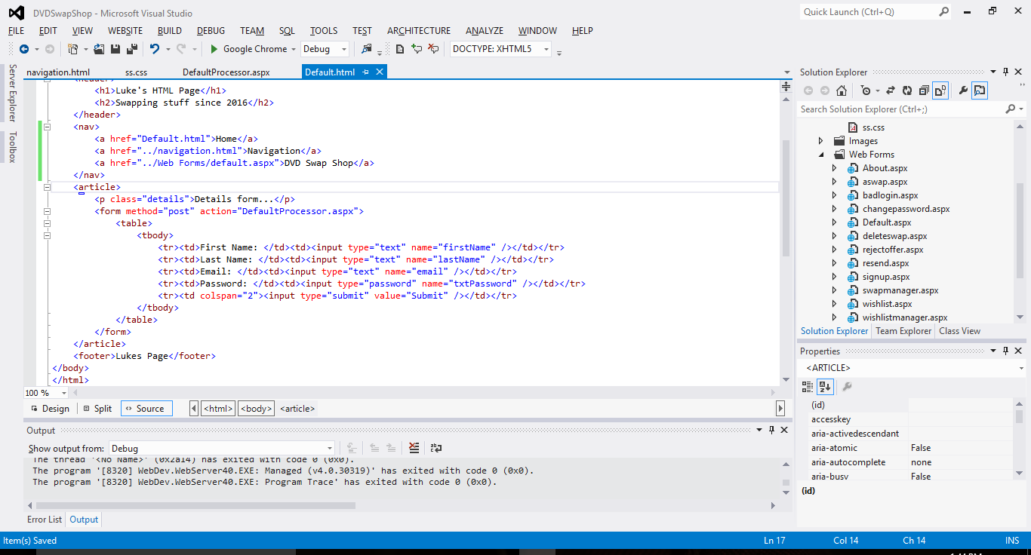
Selecting Directory
So what if we wanted to navigate to another part of the file structure all together?
We have the option to navigate through directories.
Lets navigate to the original web forms of the DVDSwapShop.
So what does this link do?

Slide 10
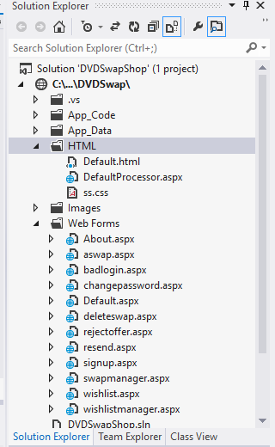
Selecting Directory
This is the file structure of the web application.

Slide 11
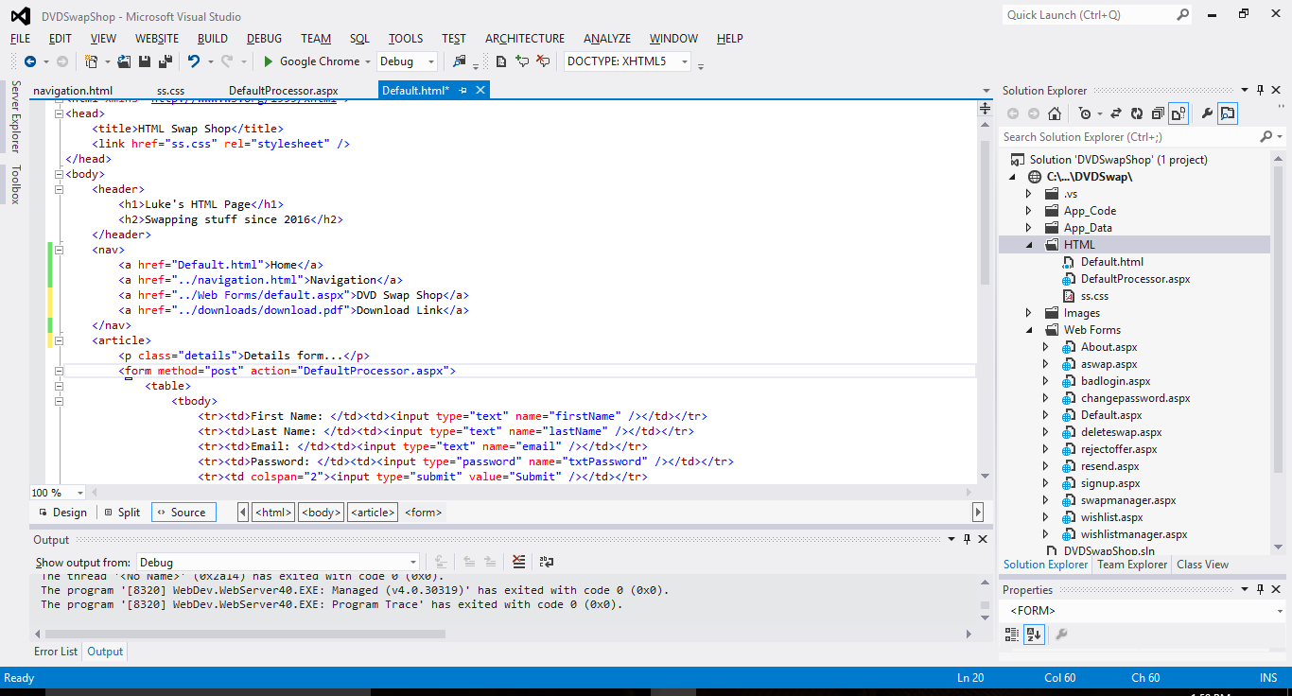
Relative Hyperlinks
So what is a relative hyperlink?
A relative hyperlink is a link within the same web application.
This includes the navigation of directories, download links etc…
As long as they are within the file structure of the web application.
Some examples of relative hyperlinks are:-

Slide 12
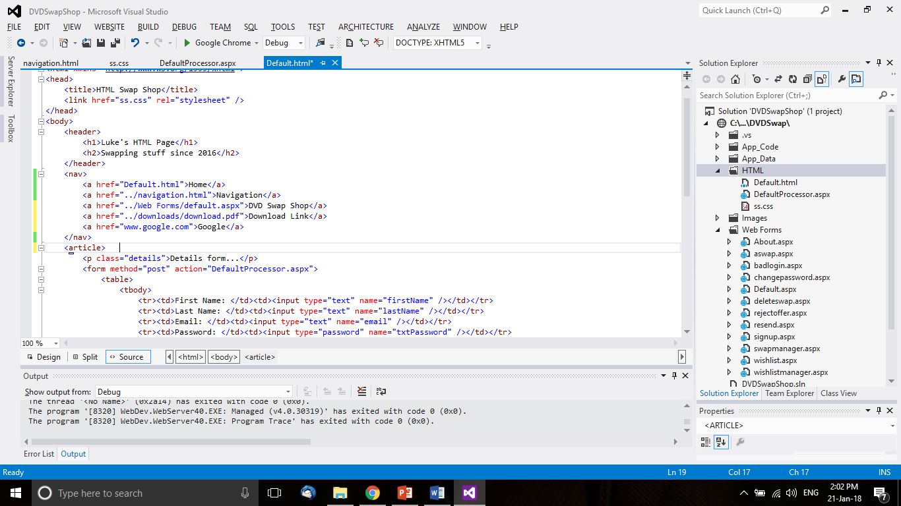
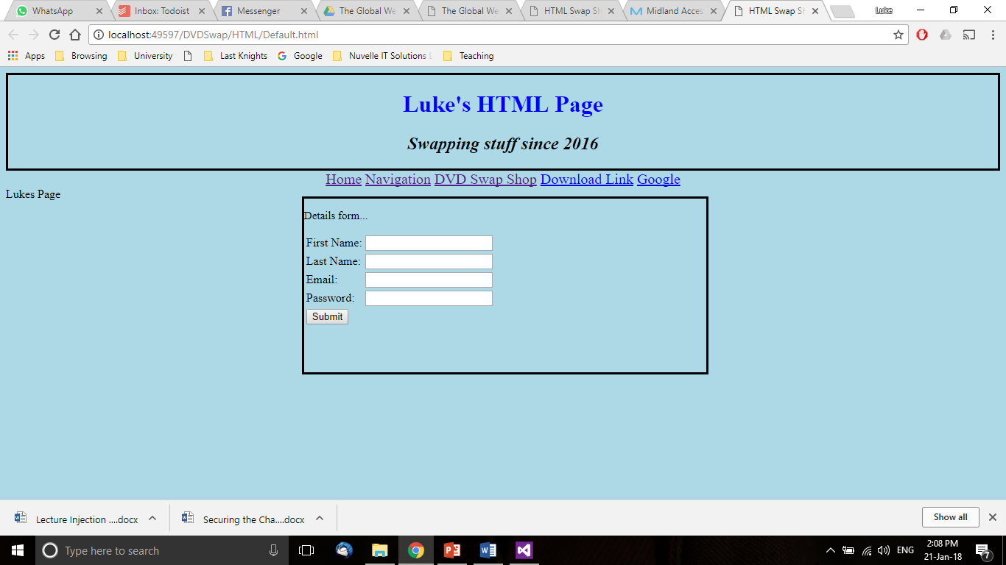
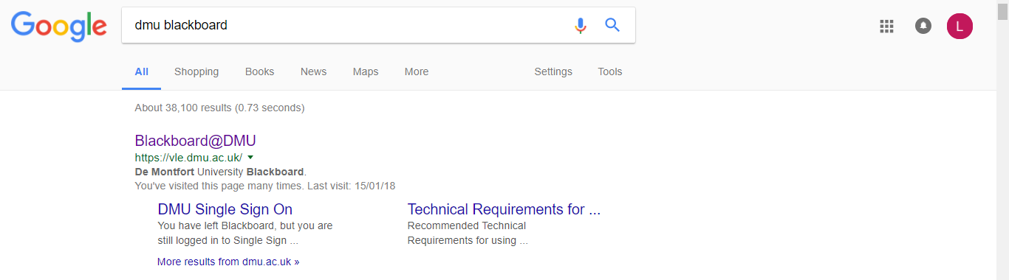
Absolute Hyperlinks
An absolute link references directly to another web application.
The link above is absolute. This is not relative to our web application.
These are created by using the full URL in the hyperlink.
By clicking . We will be navigated to their home page.
We can also attach search parameters to the URL to automatically search.
E.g. https://www.google.co.uk/search?q=dmu+blackboard

Slide 13
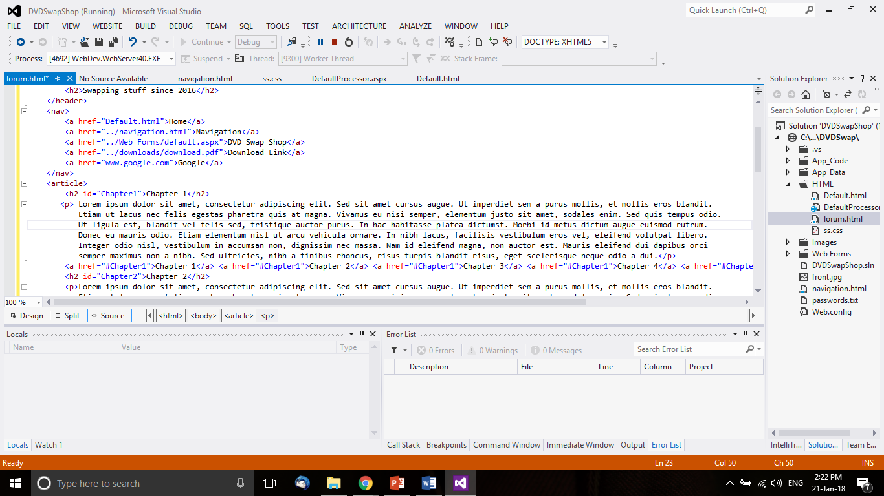
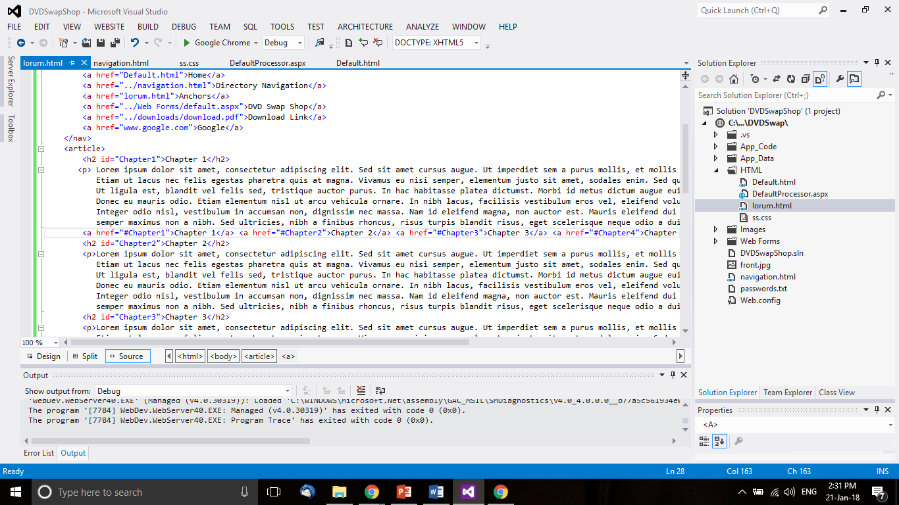
Bookmark Hyperlinks
In HTML we also have the use of bookmark hyperlinks.
These links allow a user to navigate the page by clicking links that navigate you to different sections.
These are better known as anchors.
To create an anchor.
Give a set of tags an id.
Create a link using the id to know where to link to starting with a #

Slide 14
Download Hyperlinks
Another type of hyperlink available is a download link.
This will create a normal link that when clicked will automatically download the file attached.
E.g.
This will navigate to the downloads directory and start the download for download.pdf.

Slide 15
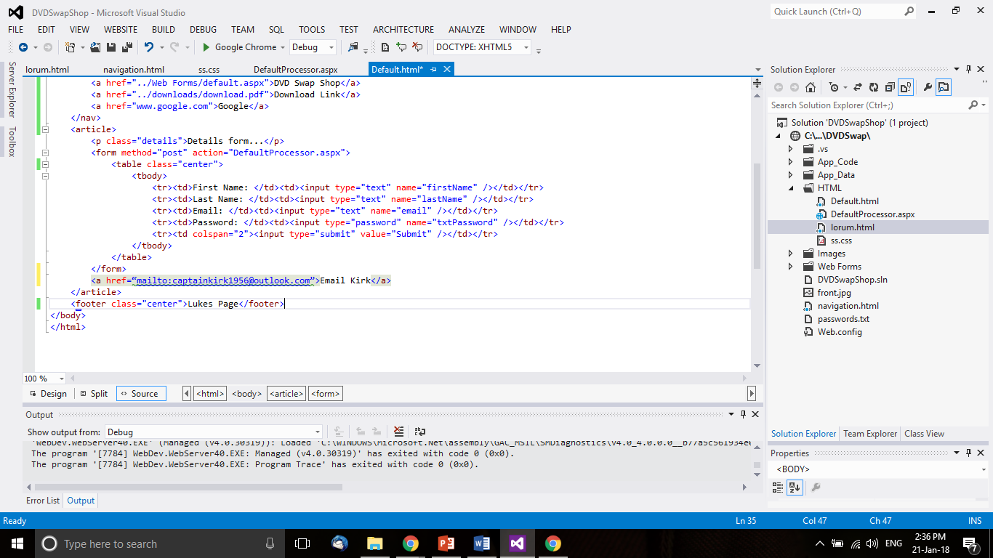
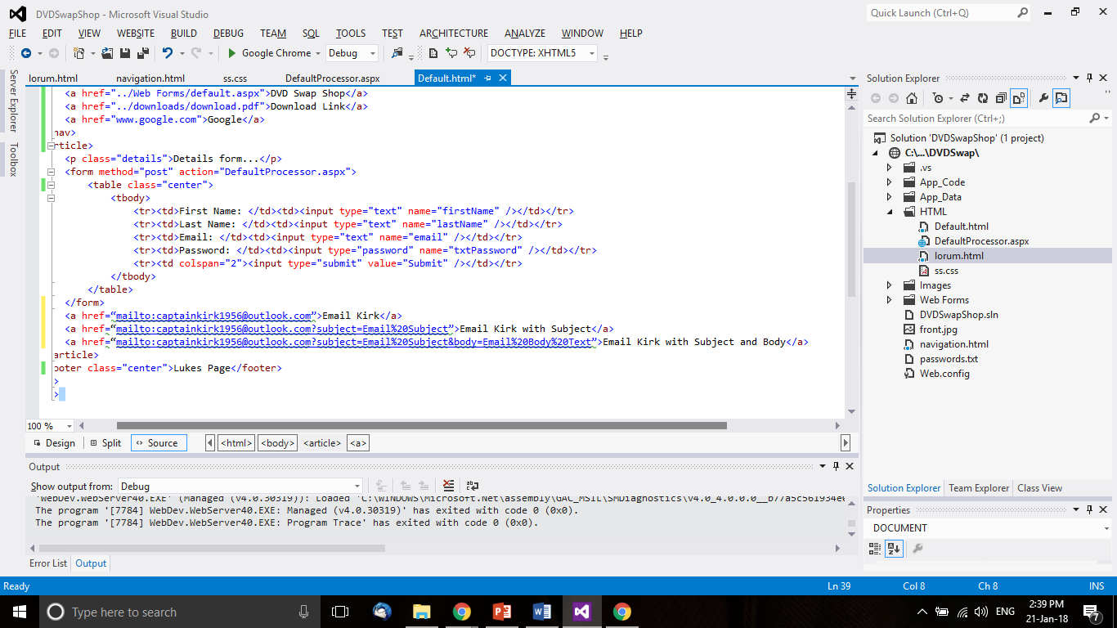
Sending Emails
Using Hyperlinks we can also send emails.
When clicking an email link, it will open the default mail client on the computer such as Outlook, Thunderbird etc.
To create this kind of link we use the following text.
What if we wanted to auto fill the subject?
What about filling in the body?

Slide 16
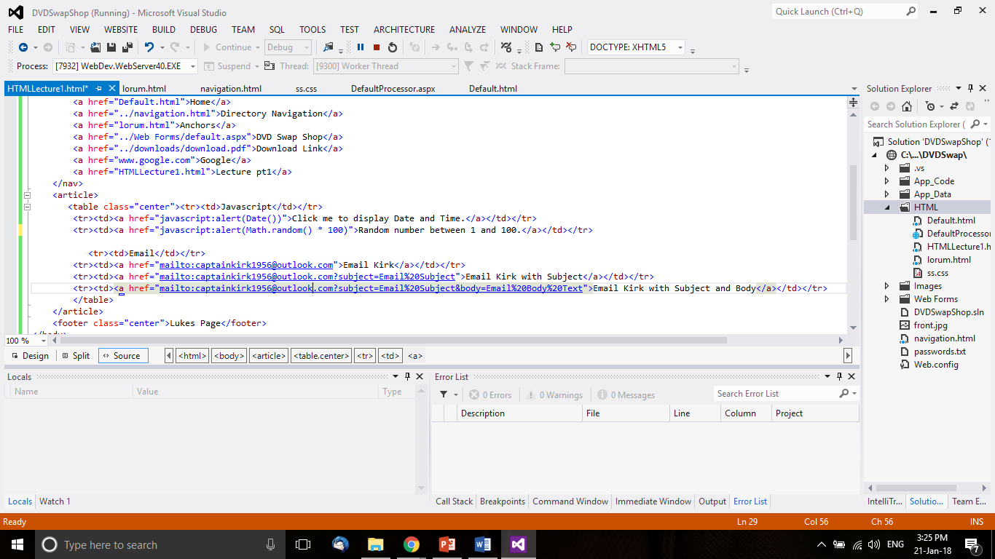
JavaScript Hyperlinks
JavaScript is a client side programming language that is used to create interactive effects inside web browsers.
Using this programming language we can perform functions within the browser.
We can also have hyperlinks that activate JavaScript code.
This code can be helpful but could also be used for malicious purpose if used irresponsibly.
Do what does the following do?

Slide 17
JavaScript Hyperlinks
This link will create a pop up box on the page that will display the current date and time to the user.
This link will display a random number between 1 and 100 every time the link is clicked.

Slide 18
Styling Hyperlinks
Styling also applies to links themselves.
Hyperlinks have multiple states to indicate what is currently happening on the page.
A blue link indicates an unvisited link. CSS = (a:link)
Link
Purple indicates a visited link. CSS = (a:visited)
Link
A link being hovered over. CSS = (a:hover)
A currently active link. CSS = (a:active)
These help identify what page you are on, where you have been and where your about to click to.
All of these can be overwritten using a stylesheet.

Slide 19
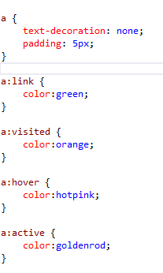
CSS for Hyperlinks
Removes Underlining from link.
Changes link colour to green.
Changes visited colour to orange.
Changes link hovering to hot pink.
Changes active links to golden rod when being clicked.

Slide 20
Other Attributes
In regards to hyperlink there is also other attributes that are used that cause them to behave differently.
Target=“_blank”
This will open the linked page in a new browser window/tab
Class=“css”
This is used as reference in the CSS for applying styles to specific parts.
ID = “id”
An identifier that is only to be used once within the style sheet or can also be used with JavaScript.
name=“element”
Specifies the name of the element.

Slide 21
Recap
We have looked at:-
What is Hypertext.
What are Hyperlinks and how they are used.
Different Types of Hyperlinks including:
Absolute
Relative
Directory Navigation
Bookmark
Email
Javascript
Styling of Hyperlinks
Other Attributes that are used.

Slide 22
Next Week…
We are going to look at HTML in regards to:-
Images
Dynamic Tables

